Slide 1



Inventory Manangement and sales analysis
View in Power BI
Last data refresh:
3/17/2023 10:53:01 AM UTC
Downloaded at:
3/17/2023 11:13:25 AM UTC

Slide 2
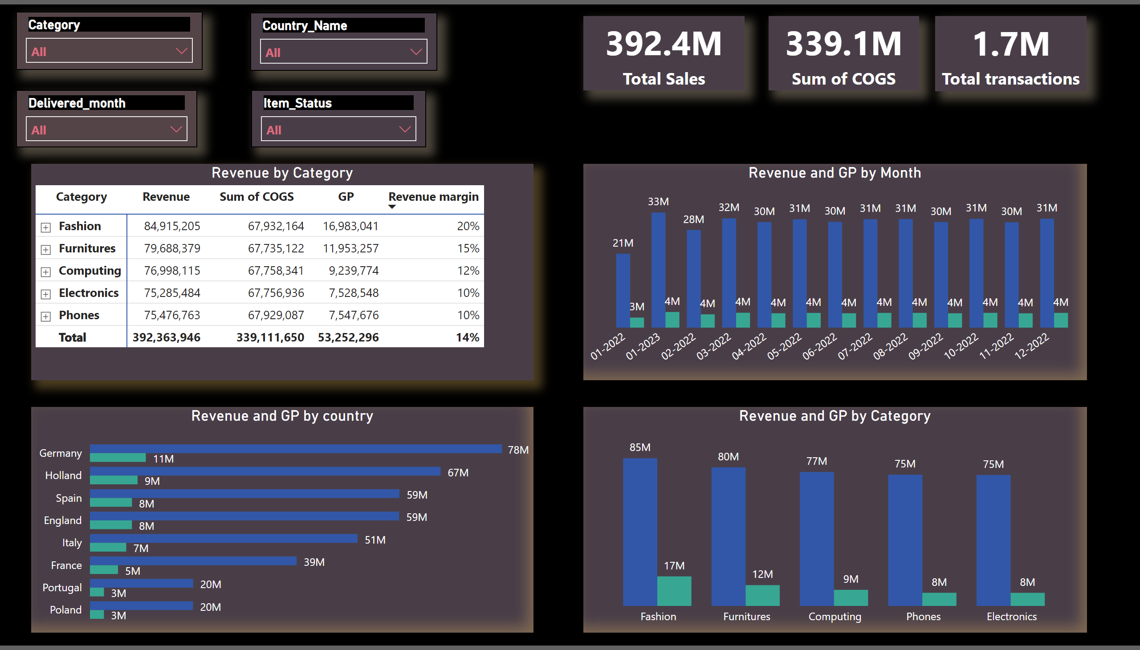
Sales Analysis
Notes:
card
No alt text provided
card
No alt text provided
slicer
No alt text provided
slicer
No alt text provided
slicer
No alt text provided
Revenue by Category
No alt text provided
Revenue and GP by country
No alt text provided
Revenue and GP by Category
No alt text provided
card
No alt text provided
slicer
No alt text provided
Revenue and GP by Month
No alt text provided

